Slide 1
Paper-Exercise: Build a Chatbot with Click-Structure

Slide 2
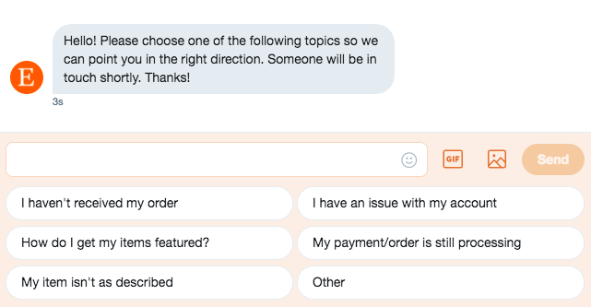
Chatbots with click-structure
pre-selected widgets with button options
choose between predefined options

Slide 3
Build a Chatbot
Look for a topic on which the chatbot should specialize. Do you want to be able to book a hairdressing appointment with it? Do you want to order pizza? Should he take on the role of therapist?
Once you have decided on a type of chatbot, you must think about what tasks this chatbot should take on.
In the next step you must build a flowchart where every information will be asked.

Slide 4
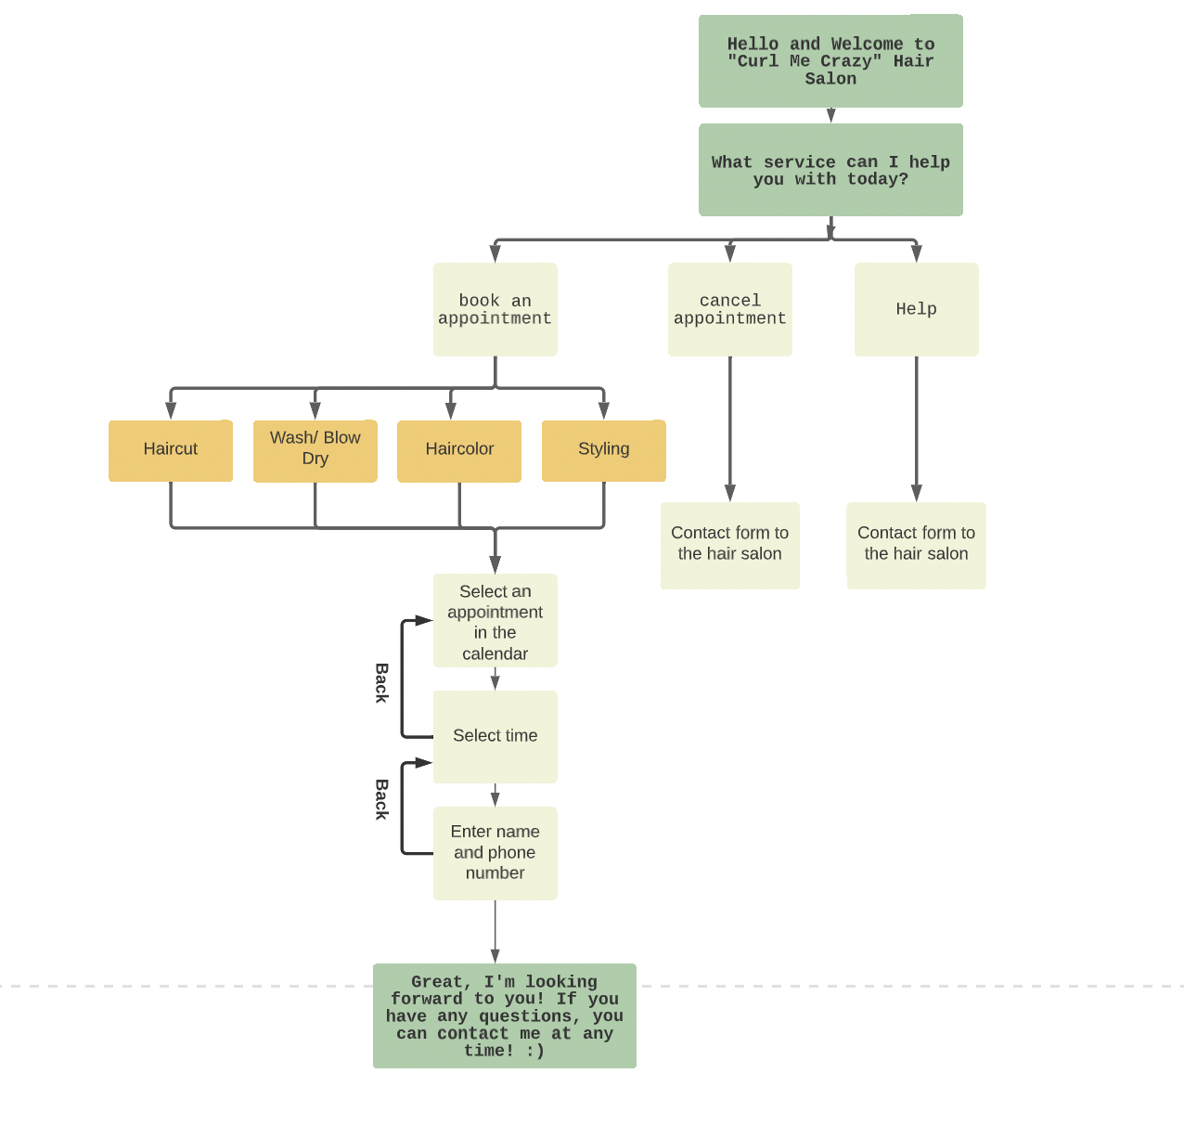

Slide 5
How to Make a Flowchart
Start with pen and paper and draw your flowchart. You can use sticky notes on a whiteboard or draw sketches with a pencil on a big paper.
Make sure that all decision-making processes make sense, and you don't end up in a loop that the user can't get out of.
Avoid flowchart dead-ends!
Keep your flowcharts as simple as possible!
Don't forget to include a closing phrase as well.

Slide 6
Additional Task
You can also consider a personality for your chatbot
Imagine a specific person and try to transfer these character traits to the statements of your bot
Don't forget that the character of your chatbot should also match the company that you are developing for

Slide 7
When your chatbot is finished, exchange ideas with another group and play through the chatbot! Does everything make sense or are there problems?

